Slide 1
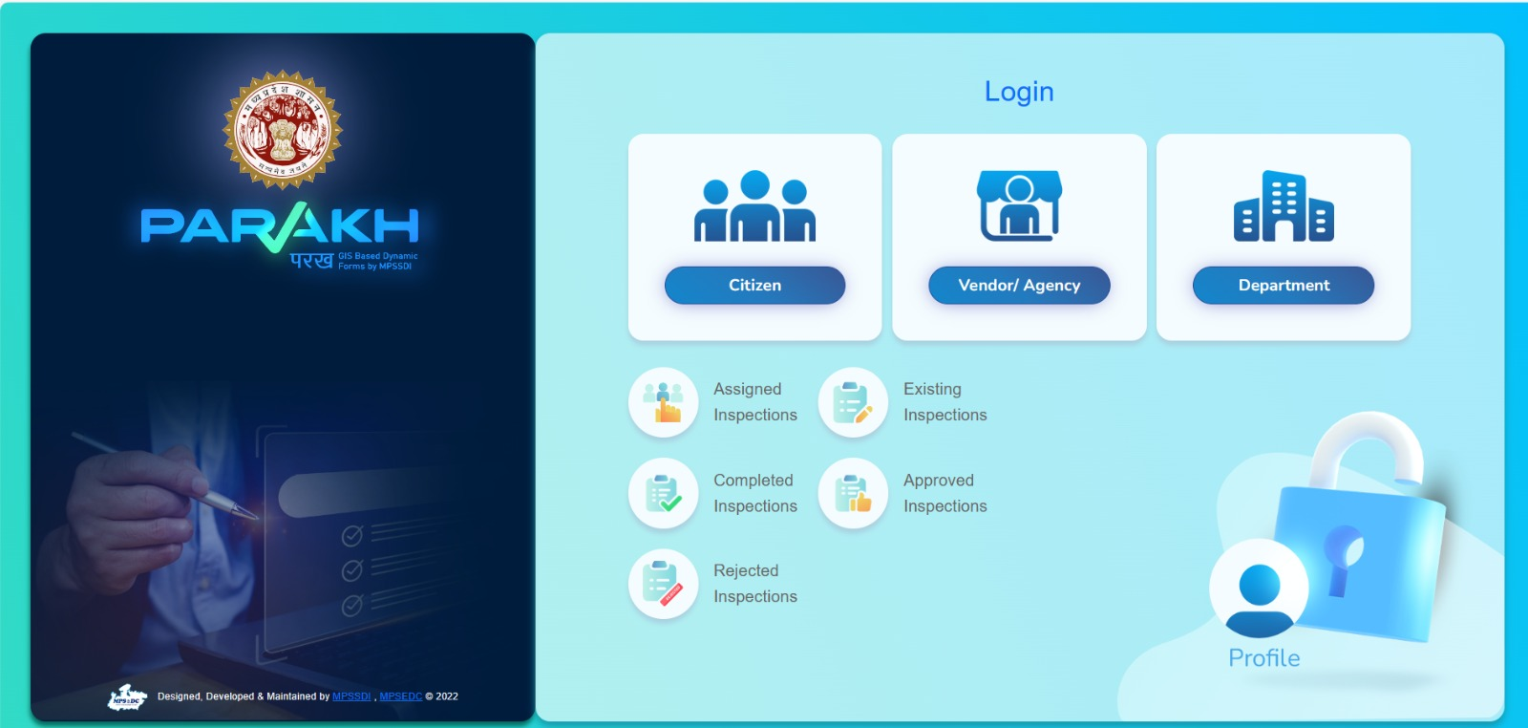
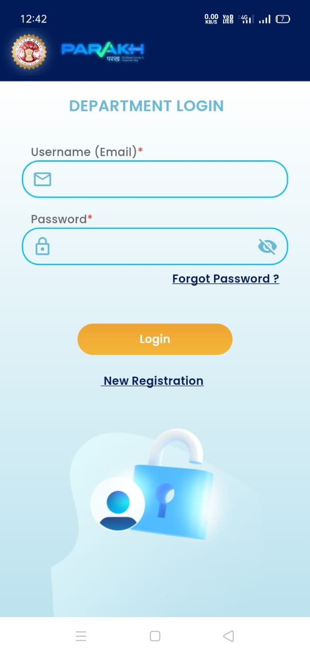
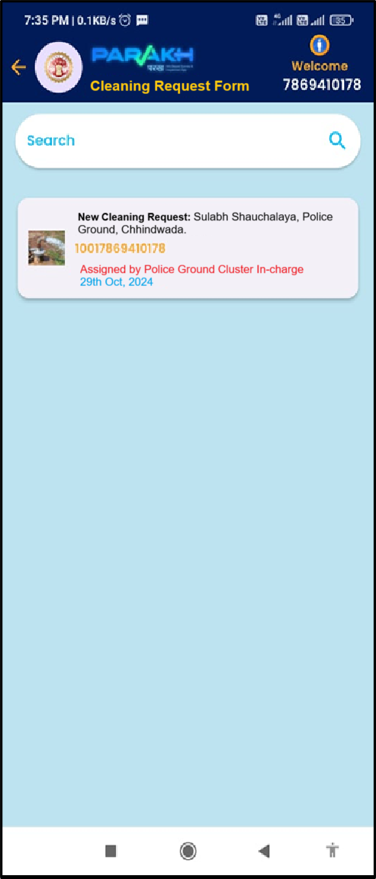
Wash on Wheel Application
Chhindwada Collectorate, MP
Features & Usage
Parakh’s framework having Geo-Tagged & Geo-Fenced features is proposed to build solution for Wash on Wheel Application for Chhindwada district.
Wash on Wheel application will enable
The asset in-charge for Anganwadi, School, Sulabh Shochalay, Panchayat, Hospitals, Hostels etc shall fill a cleaning request form to raise the cleaning request. GEO Location of the requested site will be captured. The cleaning request will be raised from the cleaning site along with a captured photo, via the Mobile App.
Allocation of the cleaning work to the available vehicle for cleaning will be done by the cluster incharge via the WEB Panel.
The allocated cleaning work, will be visible to the cleaning vehicle on their Mobile App., they will perform the cleaning work and fill the compliance form and submit. The task will be considered completed/closed, and the vehicle will be available for next service.

Slide 2





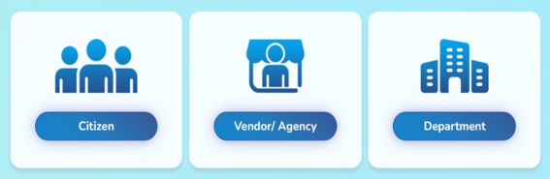
Wash on Wheel Workflow
Request for cleaning is raised by Asset In-charge via Mobile Application.
Officer at Cluster/District Level sees the cleaning request. Officer assigns the cleaning work to the available vehicle.
Notification is received to the Field Vehicle for the assigned cleaning work.
Cleaning Vehicle visualize the cleaning request and can also see the GIS map view of the path.
Conducts the cleaning work and submits the form along with the GEO tagged photo in the mobile application
Officer at Cluster/District Level sees the cleaning work completed.
As Department (Web Portal)
Login as Citizen
Mobile App
Login as Department (Web Portal)
Actors of the Application
Login as Agency/Vendor (Mobile App)

Slide 3
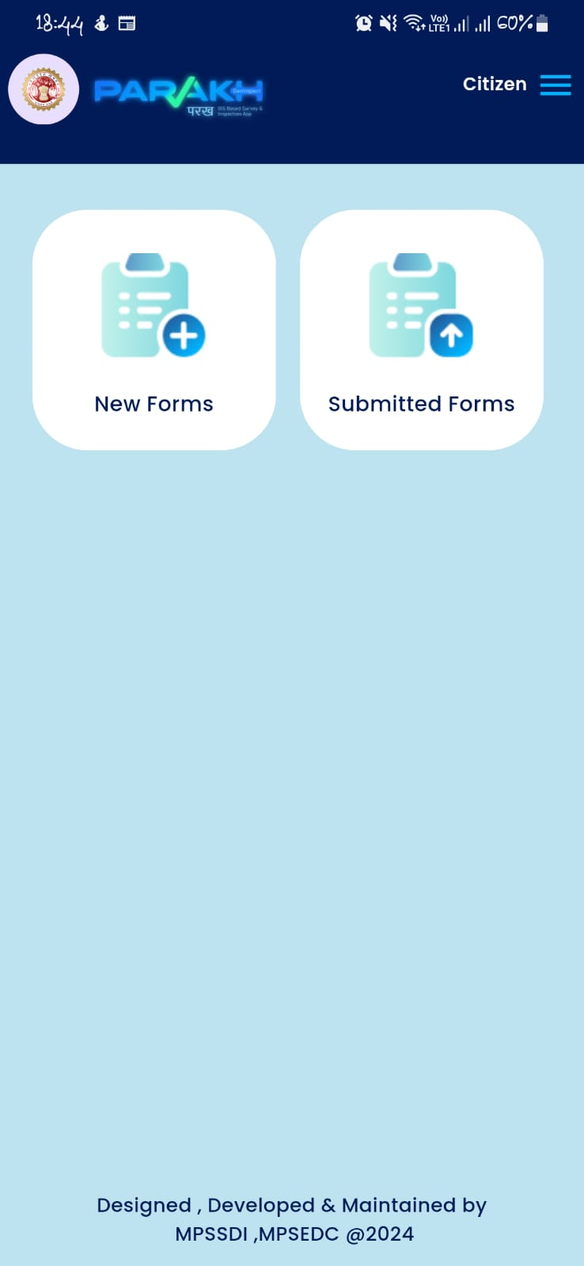
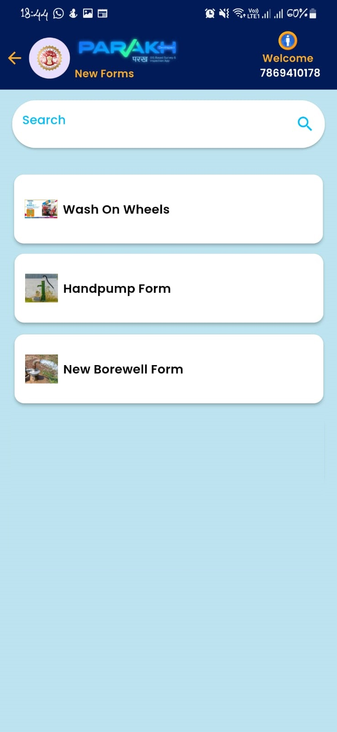
Citizen – Mobile Work-flow
Citizens can choose a form from the list and proceed to fill in the required details.
Once the citizens log in successfully, they will see a "New Forms" button. By selecting this button, a list of available forms will be displayed.

Slide 4
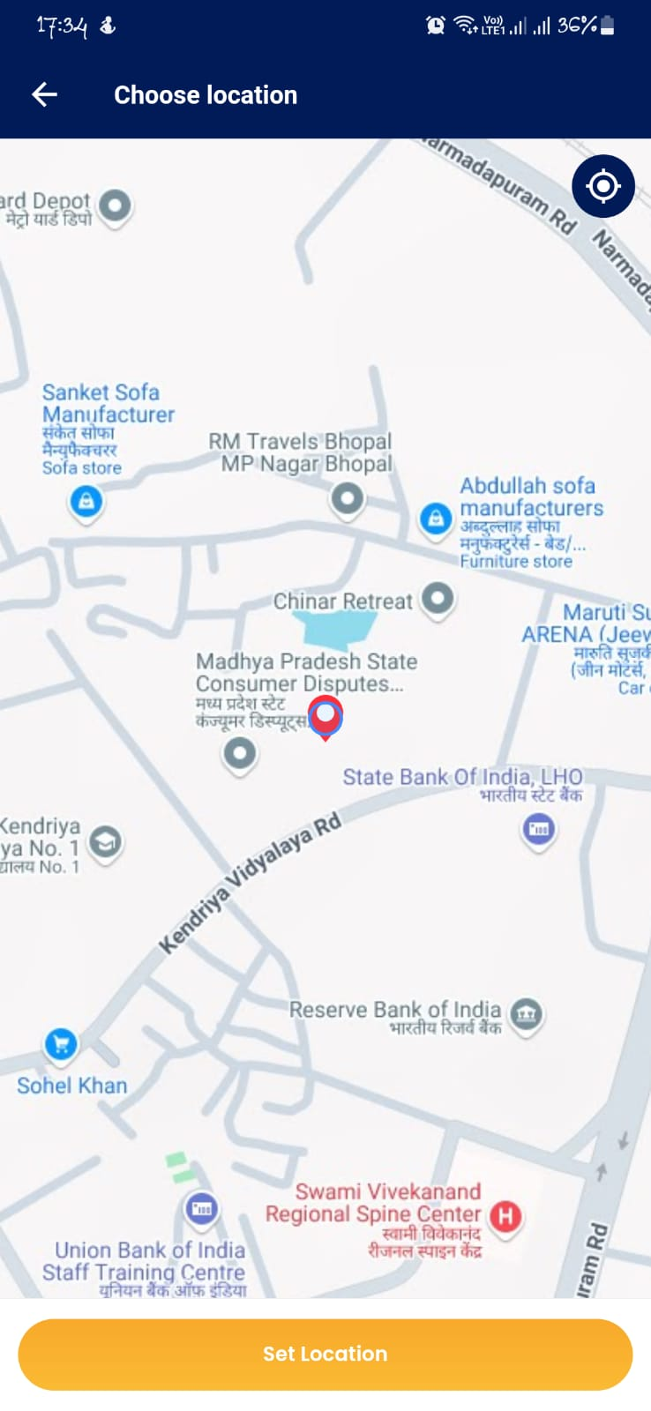
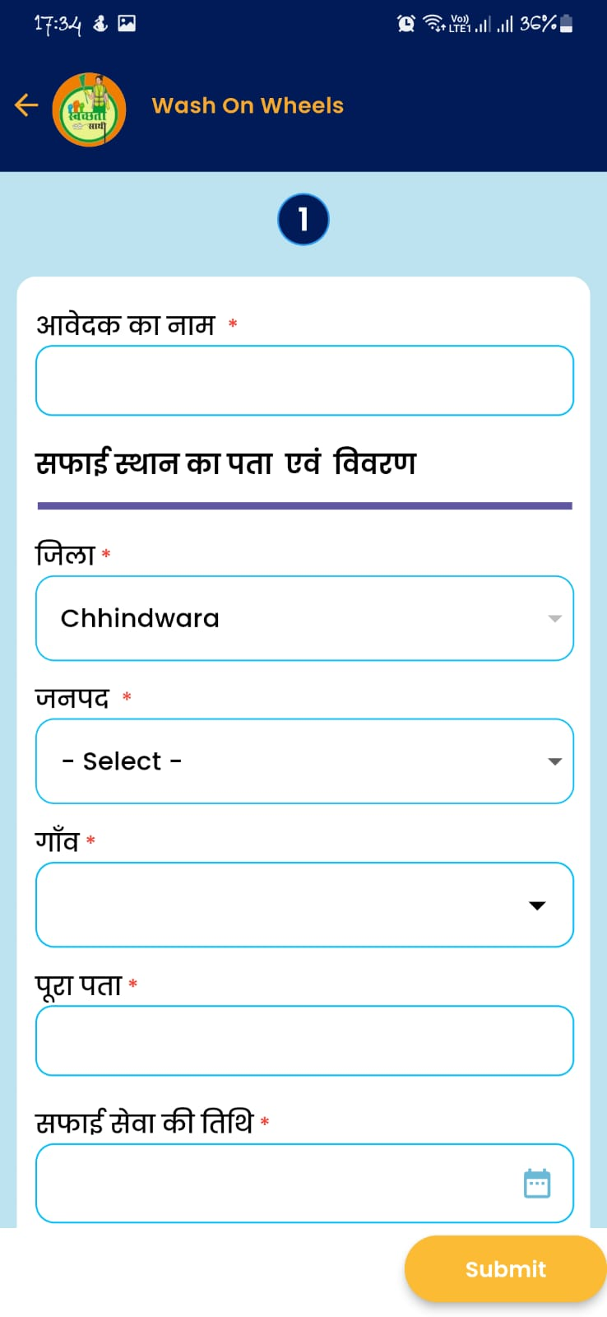
Citizen – Mobile Work-flow
Citizen first selects the location where they want to take service
Citizens fill in the required details

Slide 5
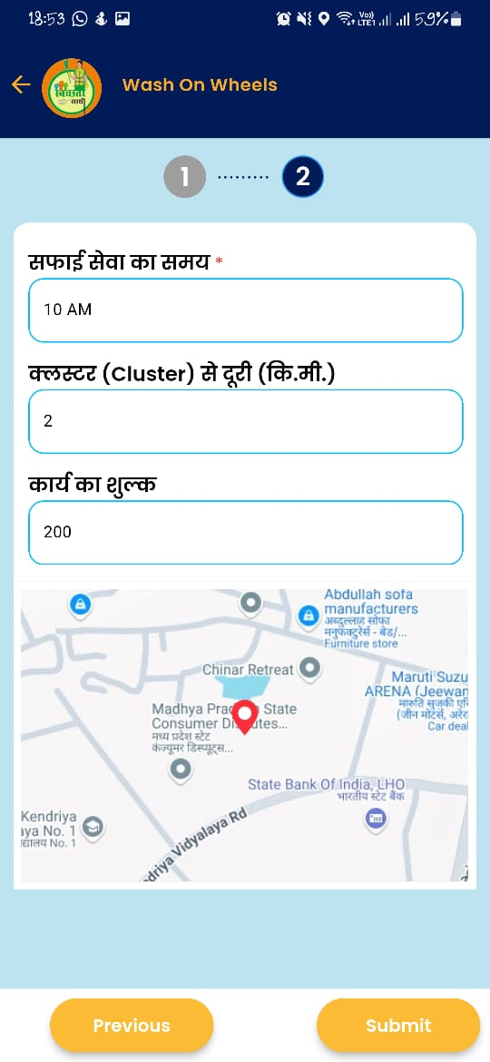
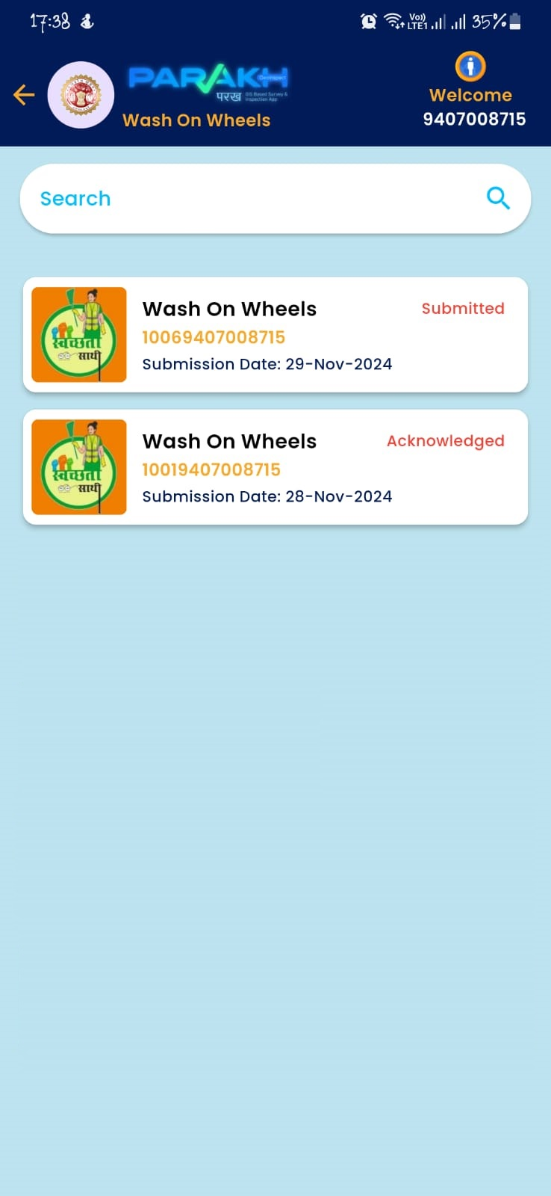
Citizen – Mobile Work-flow
Citizens can see their submitted request
The system Calculates the distance between the location where the citizen submitted the request and the cluster office.
Based on this distance, the amount is automatically calculated.
After submitting the request the request will shown on the department cluster officer on the web panel.

Slide 6
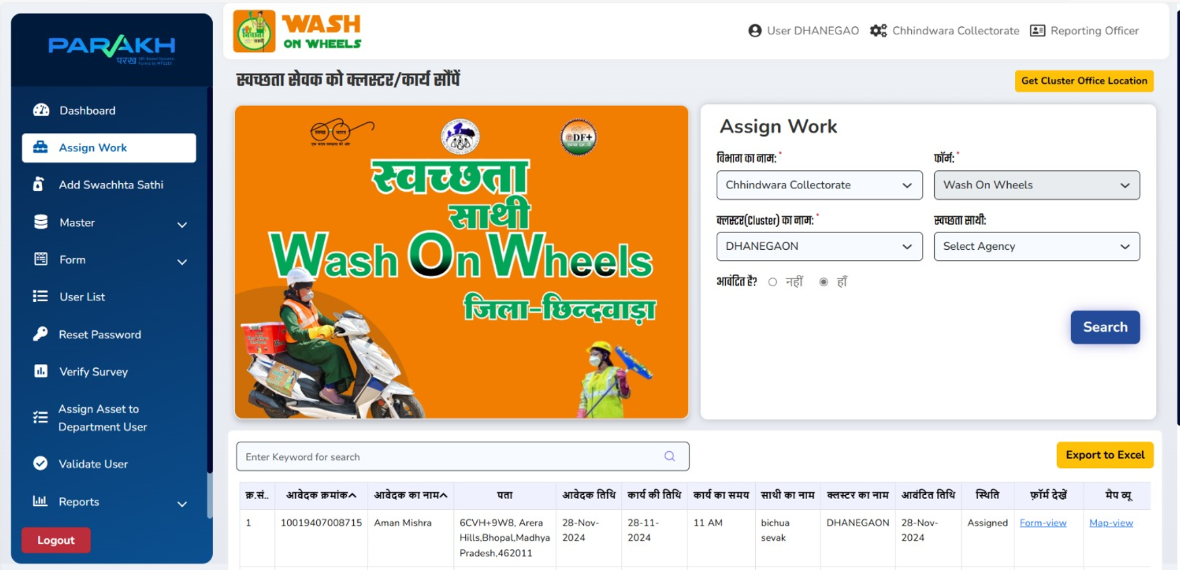
Web Panel for Cluster officer assigns the request
Cluster Admin/Supervisor will assign the sites/assets to the Vehicle-Incharge to conduct the cleaning

Slide 7
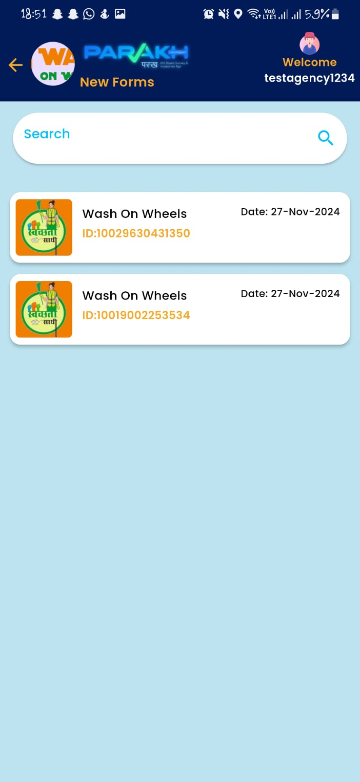
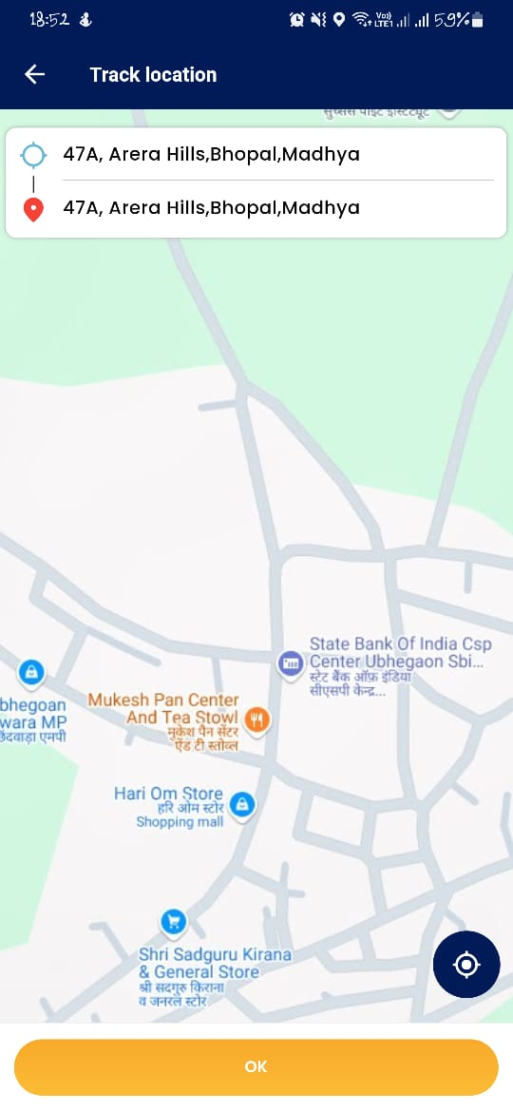
स्वच्छता साथी conducts the cleaning work and submits
On “Click” Request the GIS map view opens and shows the path.
स्वच्छता साथी Visualize the cleaning request.
On “Click” Request the GIS map view opens and shows the path.

Slide 8
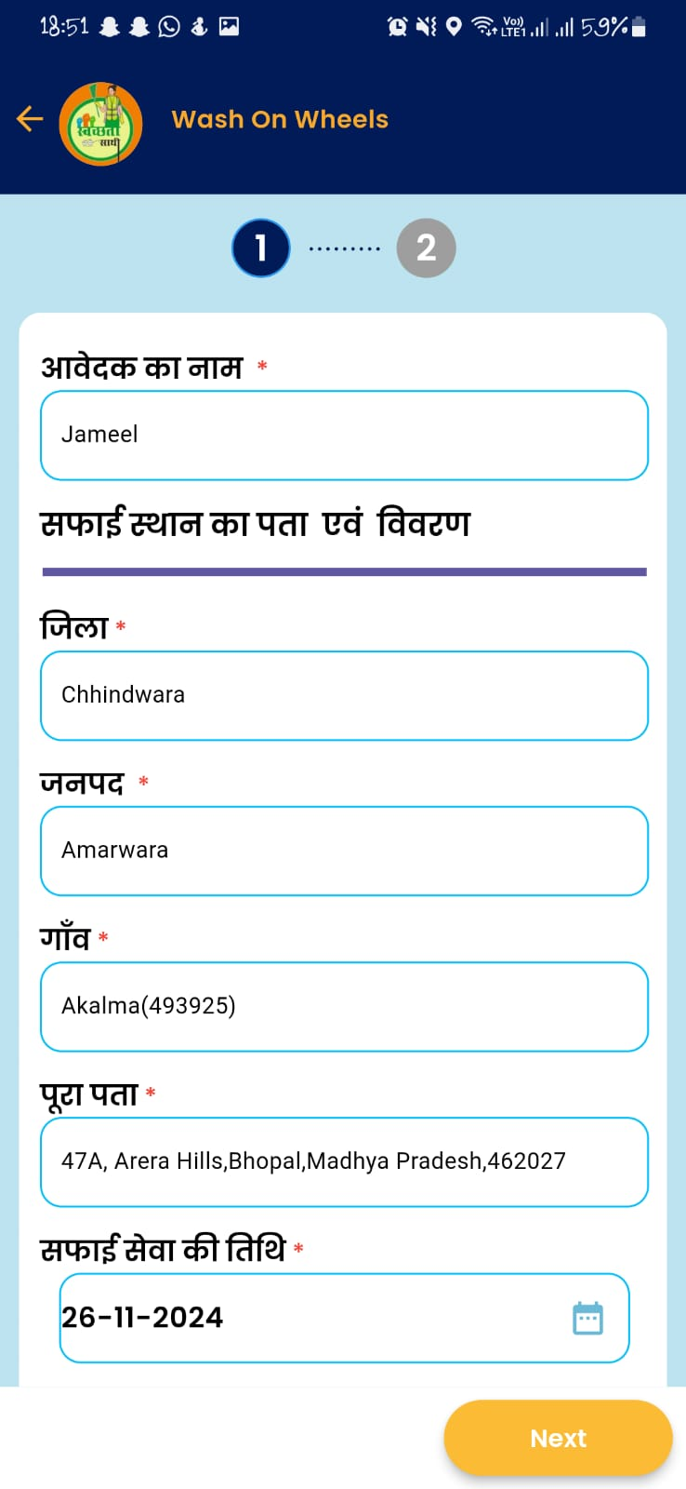
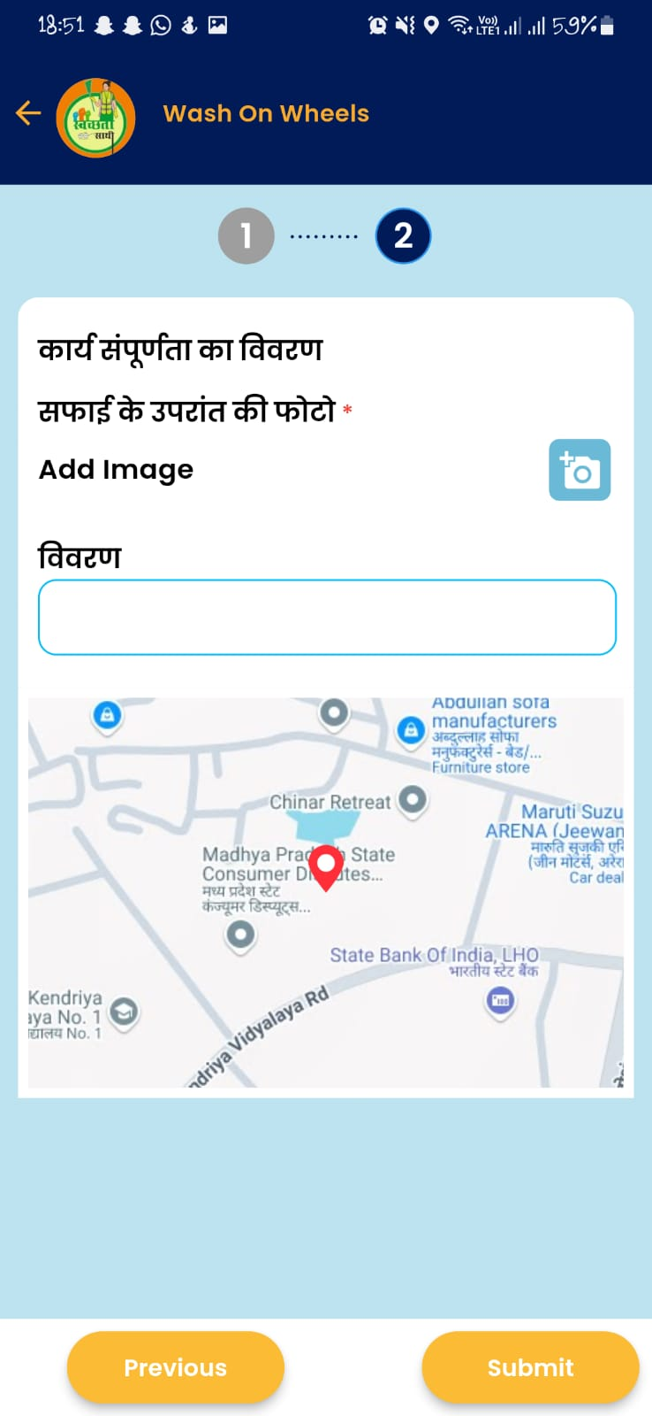
स्वच्छता साथी conducts the cleaning work and submits
Conducts the cleaning work and submits the form along with the GEO-tagged photo in the mobile app.

Slide 9
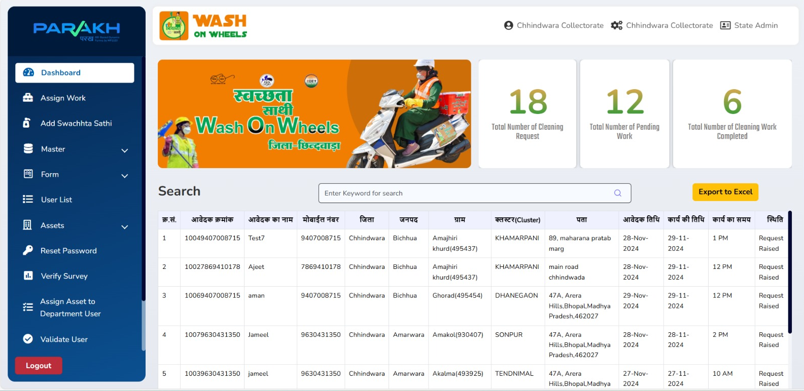
Department Admin
Officer at the State and District Levels sees the cleaning work Status.

